Slide 1


MOVIE RECOMMENDER SYSTEM
Group – II

Slide 2

Group – II Members
Mentor : Mr. Chandran Venkateshan
Chayan Dwivedi
Deepshri Deepak Kondra
Kadakuzhill Job Himalaya
Rishab Jain
Mohammad Kareem Khan
Sai Kumar

Slide 3


Problem Statement :
Develop a movie recommender system that can suggest movies to users based on their preferences, historical viewing habits. The system should provide personalized recommendations that are relevant and engaging to each individual user, while also taking into account the popularity and quality of the movies. The goal is to increase user engagement and satisfaction with the movie streaming platform by providing a more personalized and enjoyable experience.
Why is this problem important ?
The movie recommender system will provide personalized recommendations based on individual user characteristics and preferences. This level of personalization will make the movie streaming platform stand out from competitors and create a loyal user base. With a vast amount of movies available on the movie streaming platform, it can be challenging for users to find movies that they would enjoy. The recommender system will help users discover movies that they may not have found otherwise, increasing the platform's movie catalog's value and potentially increasing movie views. This will ultimately increase user engagement and satisfaction with the movie streaming platform, leading to higher user retention and potential revenue.

Slide 4


Suggestion and Outcome:
Machine learning algorithms and techniques like collaborative filtering, content-based filtering, and hybrid filtering will be used to study the historical preferences and characteristics to extract patterns from it, which would help in predicting the movies, thereby helping the users to find movies that they would enjoy.
The aim of a movie recommender system is to provide personalized and relevant movie recommendations to users based on their preferences, historical viewing habits, and demographic characteristics. The system's primary goal is to enhance the user experience by helping users discover new and engaging movies that align with their interests and tastes..
Data Sets Considered / Reference:
Movies Recommender System from Kaggle.
Reference link :
https://www.kaggle.com/datasets/rishabjain237/movie-lens-recommender-system-dataset

Slide 5

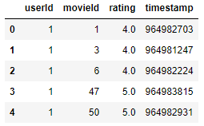
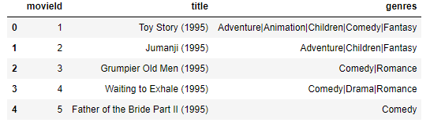


Dataset description:
Dig. a) ratings.csv
Dig. b) movies.csv
Since the movieId in the rating dataset and the movie dataset share the same IDs, we can merge the two datasets to create a single dataset that includes both the user ratings and the movie details.

Slide 6

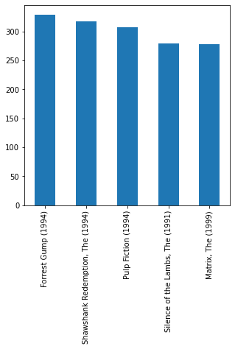
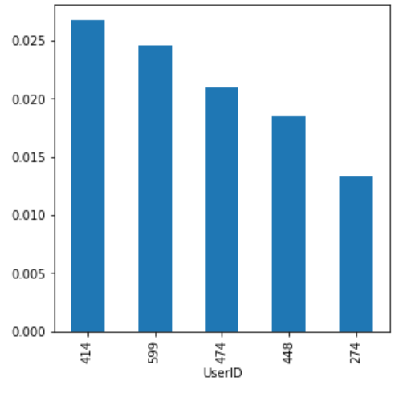
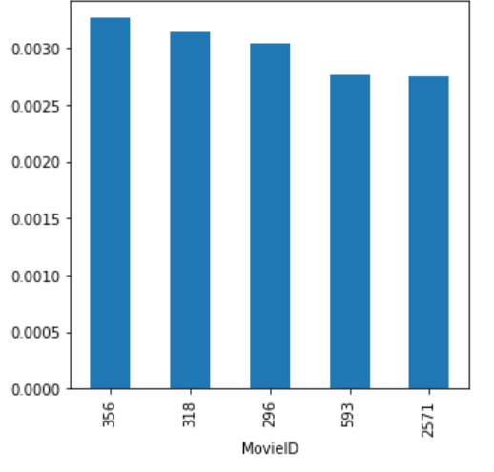
Exploratory Data Analysis
Univariate Analysis:
From bar chart we can understand that in the given dataset user with userID 414 has watched most number of movies thus giving highest number of ratings.
From bar chart we can understand that in the given dataset movie with movieID 356 has been watched the most
From the above bar chart we can understand that in the given dataset forest grumps is most watched movie.

Slide 7
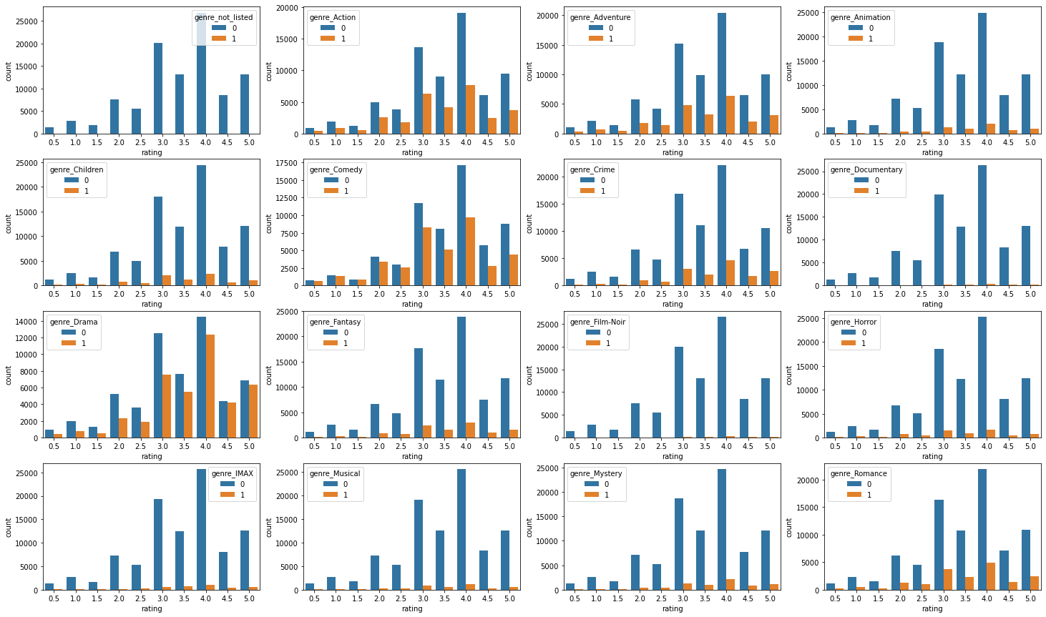
Exploratory Data Analysis
Bivariate Analysis :
From the graph, it can be inferred that movies with drama genre has been watched most thus rated the most. Drama genre as most 5.0 ratings amongst all the genres followed by comedy, action, adventure.

Slide 8

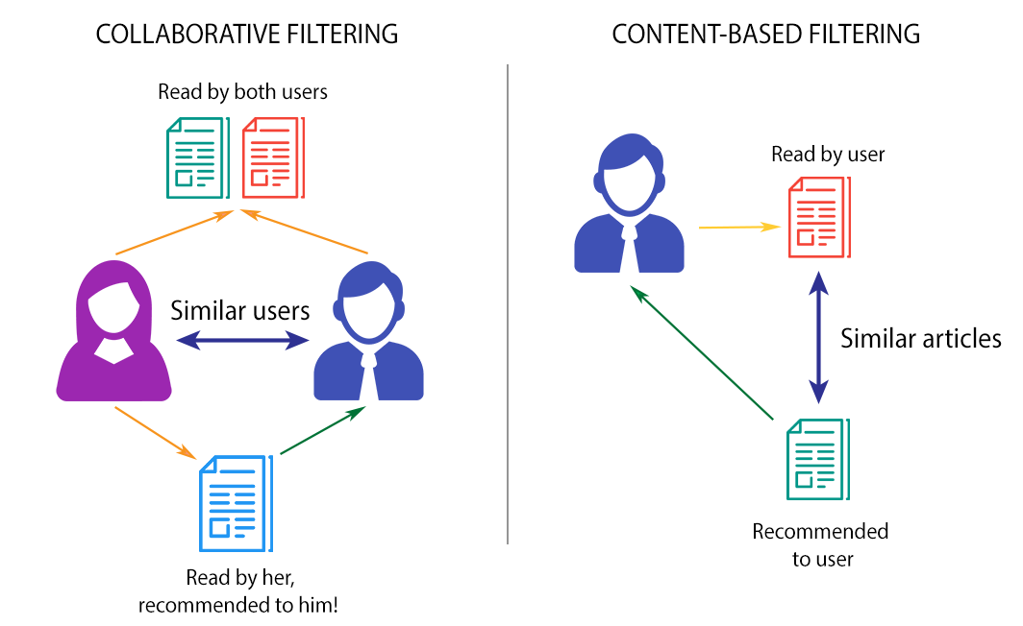
What exactly is a Recommendation System?
Recommender systems provide personalized recommendations based on user preferences and behavior.
There are two main types of recommender systems: Collaborative filtering and Content-based filtering.
Collaborative filtering can be implemented using user-based or item-based methods.
Collaborative filtering recommends items that similar users have liked or purchased.
Content-based filtering recommends items similar to those the user has liked or shown interest in.
Both methods make assumptions about user preferences.
Combining collaborative and content-based methods can improve recommendations.

Slide 9

Pros and Cons of using KNN for a recommender system?
Cold-start problem: KNN may struggle to make recommendations for new or unpopular items that do not have enough ratings or features.
Overfitting: KNN can suffer from overfitting, where the recommendations are too similar to the user's previously liked or highly rated items, and do not explore new items.
Limited interpretability: KNN provides a simple way to explain the recommendations based on the nearest neighbors in the feature space, but it may not provide a detailed explanation of the reasoning behind the recommendations.
Simple and easy to implement: KNN is a simple and easy-to-implement algorithm that does not require any training phase.
Personalized recommendations: KNN can provide personalized recommendations by finding items that are similar to the user's previously liked or highly rated items.
Flexibility: KNN can be applied to different types of data, such as user ratings, item features, or a combination of both.

Slide 10
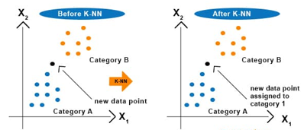
Working of KNN and why using KNN as base model
The KNN model is a machine learning algorithm used for classification and regression tasks.
It works by selecting the K instances with the shortest distance to the target instance, and using these instances to make predictions.
The process involves choosing a value for K, calculating distances, selecting the nearest neighbors, performing classification or regression, evaluating the model, tuning parameters, and deploying the model.
The K and distance metric used can affect the model's performance.
The methodology for using a base model of KNN in a movie recommendation system involves collecting and preprocessing data, extracting relevant features, building and tuning the KNN model, testing the model's performance, and making personalized recommendations for users based on the model's predictions.

Slide 11
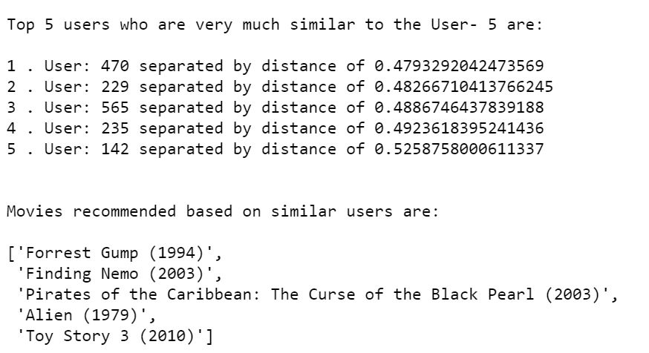
Why using KNN as Base model
The KNN model trains to find similar users based on proximity and suggests top-rated movies based on their preferences and behavior.
KNN algorithm can find the k nearest neighbors in the feature space based on some distance metric, such as Euclidean or cosine distance.
We have undertaken cosine distance in the context of movie recommendation as cosine distance can help identify movies that are similar in terms of their genre, actors, directors, and other features, even if they have different ratings or popularity levels.

Slide 12

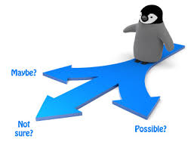
Lets discuss some scenarios from our project

Slide 13

Scenario -1 Working of Base model
We used the "sklearn.neighbors" library to import two models: the K-Neighbors Classifier and the Nearest Neighbors algorithm.
Our objective is to recommend movies to a given user based on their similarities with other users. By comparing the user's preferences to those of other users in the dataset, we can identify the users who are most similar to the input user. Then, we will recommend the top movies that would appeal to the input user based on the preferences of those similar users.
We are utilizing the KNN algorithm in our model building techniques to create a movie recommendation system, which requires inputting user ID, the number of similar users to be taken into consideration, and the number of recommended movies.
The model reshapes each user's rating space into an n-dimensional space, where n is the total number of movies.

Slide 14
Scenario -1 Item based collaborative filtering and CSR matrix
We have used Item-based collaborative filtering approach which can be effective in generating personalized movie recommendations for users, as it takes into account their individual preferences and viewing history. Additionally, it can help users discover new movies that they may not have otherwise considered, but that are similar to movies they have enjoyed in the past.
We used csr-matrix that can store the matrix in a sparse format, where only non-zero elements are explicitly represented. The "csr-matrix" method can be used to create a Compressed Sparse matrix to track the starting and ending positions of each row in the data.
We needed to select the top movies to recommend so for a better approach was to assign weights to the ratings based on each similar user's distance from the input user.
By doing this, we can ensure accurate recommendations and eliminate potential manipulation from distant users.

Slide 15
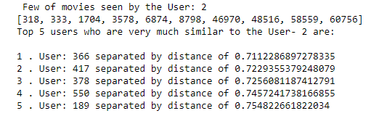
Scenario -1 Defined function get_similar_users
We defined a pre-defined function named get_similar_users function which takes two inputs, the first one is the user id and the second one is the number of similar users you want to get (by default it is 5).
It uses a pre-trained KNN model to compute the cosine similarity between the preferences of the input user and other users.
The function prints out the top n similar users with their distance from the input user and returns two NumPy arrays: the indices of the top n similar users (excluding the input user) and the distances of each similar user from the input user.
The KNN model allowed us to obtain the top similar users based on a specified number or threshold.

Slide 16

Scenario -1 Drawbacks
Drawbacks in base (first basic) model:
The initial recommendation system recommends movies already seen by the input user
The system may recommend movies not seen by any similar users

Slide 17
Scenario -2 Defined function
filtered_movie_recommendations(n)
In order to overcome the limitations of the original model, a modified KNN model has been built to address these issues.
A function is defined to remove movies already seen by the current user and unseen by similar users.
We defined a function named filtered_movie_recommendations(n) takes an input parameter n which represents the number of recommended movies to display.
It filters out the movies already watched by the input user and movies not seen by any of the similar users.
The function first finds the index of the last movie with a mean rating of 0 and sorts the list of mean ratings in descending order.
It then creates a filtered list of movies that have not been watched by the input user and have been seen by similar users.
It creates a final list of recommended movies with a maximum length of n, and displays the list using the pprint() function.
If no movies are found that meet the criteria, the function prints a message indicating that there are no movies left to recommend.

Slide 18
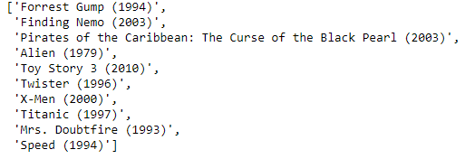
Scenario -2 Defined function recommender_system
Another function named recommender_system is defined which is the combination of get_similar_users function and filtered_movie_recommendations(n) function that takes three inputs: user_id, n_similar_users, and n_movies.
It displays the movies already watched by the input user, obtains the top n_similar_users similar to the input user, calculates their weightage, and generates a new rating matrix.
The mean rating for each movie is calculated using this new rating matrix, and a list of recommended movies is generated based on these mean ratings.
The function filters out the movies already watched by the input user and displays the top n_movies recommendations.
If no such movies are available, the function suggests an increase in the number of similar users to consider.
The output of the function filtered_movie_recommendations(n) has been displayed above.

Slide 19
Scenario -3 Defined function get_similar_movies
Transforming the model to create an n-dimensional rating space for each movie, where n is the total number of users who have rated the movies.
A KNN model is been trained to find movies that are closely similar to the input movie, and the top recommended movies are suggested based on the ones that are closely aligned with the input movie.
We defined another function named get_similar_movies which takes a movie name and the number of similar movies to recommend as input.
It finds the index of the input movie in a dictionary and creates an input array for a KNN modified model to represent its rating space.
The function then uses the KNN modified model to find the top similar movies based on their ratings by users, and displays the names of those movies.

Slide 20
Scenario -3 Defined function get_possible_movies()
The get_possible_movies() function takes a string movie as input and returns a list of possible movie titles that match the input string, ignoring capitalization.
It creates a copy of a list containing all the movie titles in lowercase and iterates over each character of the input string to build substrings.
For each substring, it filters out the possible movies that do not contain the substring, sorts the matches alphabetically, and updates the possible movies list.
Finally, it returns the possible movies list.

Slide 21
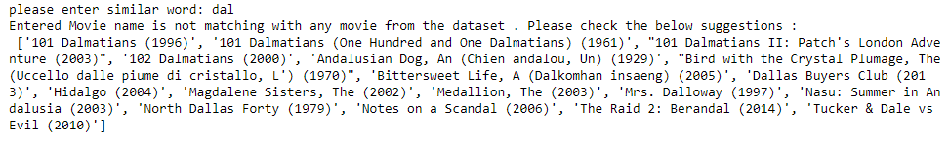
Scenario -4 Defined function spell_correction()
The function spell_correction() is used to correct the spelling of movie names in case a user doesn't know the exact name of the movie but knows some related words.
The function takes the input word as the misspelled movie name and outputs a list of suggested movie names that the user might have intended to type.
Based on the similarity between the misspelled name and the names of all the movies in the dataset it searches for similar words in a dictionary using the Levenshtein distance algorithm.
If any similar word is found, it returns the most similar word to the input word as the corrected spelling.
Above is the output of defined spell_correction() function which generates a list of suggested movie names based on the input string, which could contain a misspelled movie name.

Slide 22
Scenario -4 Defined function star_based_visualization()
A Knowledge-Based Recommender System is a type of recommender system that suggests movies to users based on their explicit inputs or preferences, as well as on domain knowledge or expert knowledge about the movies being recommended.
It matches user preferences with a set of predefined rules or attributes associated with the movies in the recommendation space, such as recommending movies of a specific genre or director based on user preference.
These systems are often used in cases where there is limited user data available or where the recommendation space is highly specialized, such as in the case of recommending niche or lesser-known movies.
We defined a function named star_based_visualization which takes a dataframe as input, which contains information about the movies, including their ratings.
It generates a bar plot showing the frequency of each rating given by users.
It also prints the total number of users who watched the movies in the given dataframe.
The purpose of this function is to visualize the distribution of movie ratings in the dataset.

Slide 23
Scenario -4 Defined function recommendations_genre(genre)
The function recommendations_genre(genre) takes a movie genre as input and recommends top-rated and popular movies from that genre to a new user.
The function first filters the movie dataset to get all movies belonging to the input genre.
It then merges this filtered dataset with the rating dataset to get the average rating of each movie in that genre.
The function then recommends top-rated movies and popular movies separately to the user.
The recommendations are based on the number of users who watched a movie and the average rating it received.
The function uses a while loop to find the best movies to recommend based on popularity and rating, and prints the final list of recommendations to the user.
The function also includes visualizations of the recommended movies using the star_based_visualization function.

Slide 24

Hybrid Recommender System:
This function is the combination of all functions that implements a hybrid recommender system that combines two different approaches to generate personalized movie recommendations.
First, if the user provides a valid user ID, the function calls the recommender_system function to generate a list of recommended movies based on collaborative filtering.
If the user provides an invalid user ID, the function offers the user the option to search for similar movies based on the exact movie name. If a movie name is found, the function calls the get_similar_movies function to generate a list of recommended movies based on item-item similarity.
If the user inputs invalid movie name then the function offers the user another option to search similar movies based on familiar words. If the user inputs familiar word, the function calls the spell_correction() function to generate a list of movies that are familiar to the input word.
If a user doesn’t have a familiar word to search with then the function offers the user to get recommendation based on genre. The function display a list to genres available to select from. As the user inputs the genre the function call the recommendations_genre() which generates top rated movies, most viewed movies, movies with > 300 views and rating > 4.0 of the input genre.

Slide 25
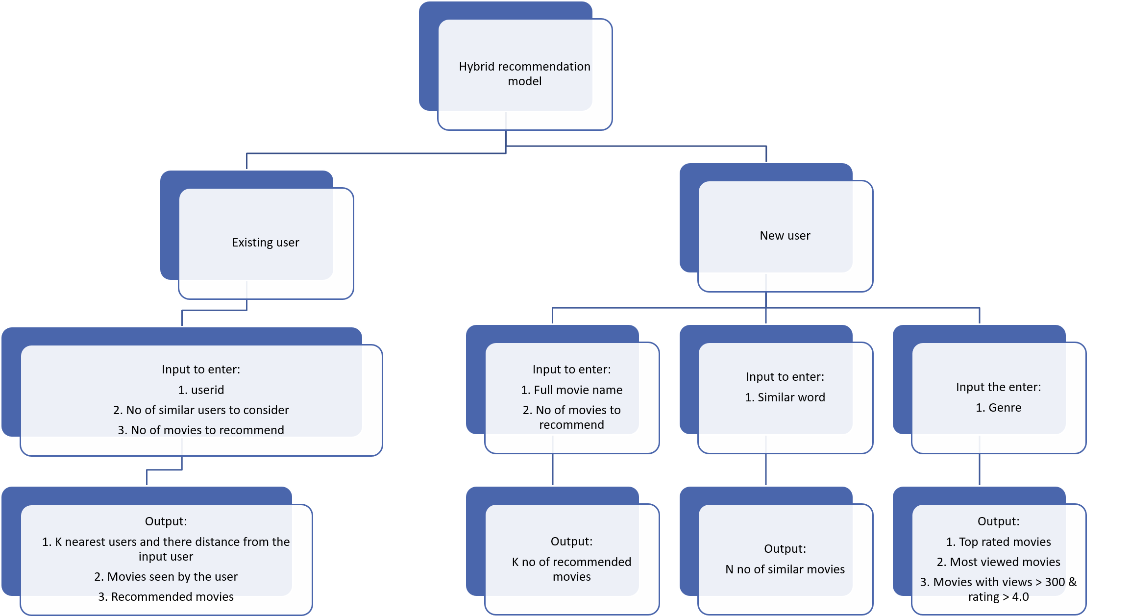
Hybrid recommendation model Flow:

Slide 26


